Slide 1
R Session 4
Review of measures of impact, confounding and effect modification, basic logistic regression.

Slide 2
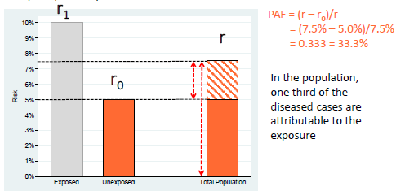
Review of PAF
Proportion of all cases in the whole population that may be attributed to the risk factor.
Identifies risk factors which cause the most disease in the whole population.

Slide 3
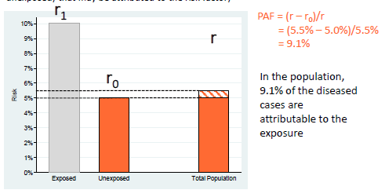
Review of PAR
The absolute difference between the risk and rate in the whole population (r) and the risk or rate in the unexposed group.
Burden of disease in the whole population which is attributable to the exposure of interest.

Slide 4
Practical (if you wish)
For everyone who went to hospital from Jan onwards, were men significantly more likely to be admitted with COVID than women?
Steps
  Create a new dummy variable of COVID 1 or 0
  Extract that var and gender
  Tabulate
Use chisq.test

Slide 5
Causality
When an association is seen between an exposure and outcome, what this be due to?
  Chance (p < 0.05 means 1 in 20 random chance)
  Bias
  Reverse causality – outcome causes exposure
  Confounding
  Causal true association.

Slide 6
Bias is a study design problem
Random error
  The larger the sample, the smaller this error. Sample size calculations help with this.
Systematic error
  Confounding (more later)
  Selection bias
  Information bias
Notes:
Selection bias in a case-control study can arise when:
“cases (or controls) are included in (or excluded from) a study because of some characteristic they exhibit which is related to exposure to the risk factor under evaluation.” (Breslow & Day, 1980, p23.).
Bias in selection of controls
In case-control studies, the control group is selected to provide an estimate of the prevalence of exposure in the population from which the cases arose.
The ‘ideal’ case-control study, in which there is unlikely to be selection bias, is one in which:
i. there is a clearly defined population (the ‘base or source population’)
ii. all cases arising in that population, in some defined time period, are included in the study
iii. controls are a random sample of that population

Slide 7
Selection bias in case control studies
Can arise when cases or controls are included in (or excluded from) a study because of some characteristic which is related to the exposure under investigation.
An ideal case-control study has
  A clearly defined population
  Perfect collection of all cases arising in that population in a time period.
  Controls are a true random sample of that population
What about patients in hospital?
  Hospital controls are a source for bias if not handled correctly!

Slide 8
Hospital based controls and bias
These can be chosen from other patients in the same hospital, at the same time, and THAT THEIR CURRENT CAUSE FOR ADMISSION HAS NOTHING TO DO WITH THE EXPOSURE OR OUTCOME UNDER STUDY.
  This only relates to the current admission, pts with a hx of exposure related disease shouldn’t be excluded.
The assumption here is that if these patients developed became a ‘case’ then they would also present to the same hospital.
This might be a reasonable assumption depending on which diseases are under study, and what the patients are like. Or it might be very difficult e.g. tertiary referral centre for the disease.
Controls should be recruited from a range of disease specialties, so it dilutes the chance that their disease is in fact related to the exposure of interest.

Slide 9
Should you use hospital controls?
For using:
  Easier, cheaper, faster study
  Reduction in recall bias (people remember exposures differentially whether they’ve developed a disease or not – hospital records help with this.
Against using:
  People in hospital are NOT the underlying population
  There are lots of exposures which are over-represented in hospital patients compared to the general population of ‘potential hospital users to become cases’ (smoking, drinking, poverty, living conditions). If these are over-represented in the controls relative to the cases and are an exposure of interest, this can introduce selection bias.
Notes:
Can use both, but then you have to argue about which is better!

Slide 10
Bias in case selection
We can’t always pick up every case
Sometimes selecting those with an exposure is a self fulfilling prophecy simply because of how they present to the study – as in those with an exposure of interest will present because the disease is worse, or that they present more to hospital.
People with >1 disease or risk factor are more likely to be hospitalised than the general population or those with only the outcome of interest, may be less healthy, and may be more likely to be recruited into YOUR study rather than being treated in the community
  This is known as Berkson’s bias if you want to show off to your educational supervisor.

Slide 11
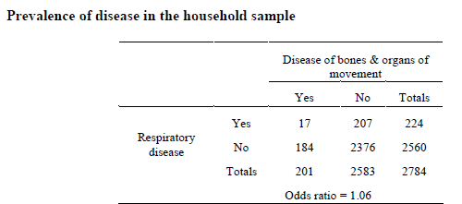
Wider population distribution
No association?

Slide 12
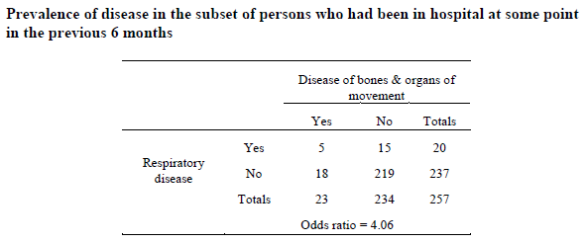
Population who would present to hospital
Association?

Slide 13
Detection of cases can introduce bias
Unless a gold standard investigation is done, doctors may label a diagnosis (and therefore an entry into your cases) as a certain disease based on the history of exposure more than a patient with the exact same symptoms but no exposure history.
Screening to pick up cases can also cause bias (more important for evaluating screening tools)
More on bias in later sessions.

Slide 14
Confounding
In a perfect epidemiological world all studies would be interventional randomised controlled trials – thereby isolating the exposure and ensuring causality.
Unfortunately departmental budgets and ethical considerations mean that most studies are observational.
  We can observe associations but association doesn’t always equal causation.
This means that the exposure is not randomised, and there are typically other variables which are associated with the exposure of interest and affect the outcome of interest – these are confounders

Slide 15
Be careful in your definition of confounders
Confounders have to be INDEPENDENT risk factors for disease, not on the causal pathway, and also associated with the exposure.
These are specific to the study hypothesis in question.
Smoking → CHD
  Adjust for alcohol intake?
Diarrhoea → death
  Adjust for dehydration?

Slide 16
Stratification
You can stratify your effect estimates by the different levels of your 3rd ?confounding variable
If these stratified measures of effect are similar to each other, but different to your initial ‘crude’ unadjusted measure of effect, this can be used as some supporting evidence for confounding.

Slide 17
Practical
Load in the dataset test_smoking.csv
Install the package and load the library of “EpiStats”
Type ?CCInter in the console
Create tables for association between chemical exposure and lung cancer, stratifying on smoking status.
What do these show?
Now try using smok as the exposure of interest, and chem as the ?confounding variable.

Slide 18
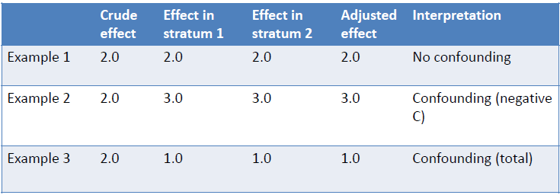
Identifying confounding

Slide 19

How much of a difference in MoE matters?
Up to you
irl there will always be residual confounding depending on how many variables you capture and how you classify the data (e.g. age bands)
THERE IS NO STATISTICAL TEST FOR CONFOUNDING

Slide 20
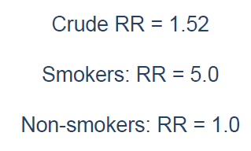
Effect Modification / Interaction
Suppose the OR of effect for chem on lung_ca was different in different in the different stratum for smok.

Slide 21
NOT CONFOUNDING
Interaction is all about the effect of one variable modifying or depending upon the effect of another.
There IS a statistical test for effect modification, but because it’s comparing between stratum it is often very low power, and often here is where you have to make a decision whether a variable is an effect modifier, confounder, or not related on your own.
  In addition because p < 0.05 means one in 20, and you probable have 5 or more variables, if you run association tests between all your variables you’re likely to detect spurious interactions – always be specific in your investigations a priori!
If a 3rd variable is an EFFECT MODIFIER it is highly misleading to summarise the measures of effect into one summary estimate
  PUBLISH STRATUM SPECIFIC MEASURES OF EFFECT.

Slide 22
Conclusions on Effect Modification
Interaction occurs when the presence of one factor modifies the effect of another – sounds simple?
It’s an important independent property of relationship between the two factors, and their influence on disease in a population, or in risk prediction.
Rather than statistically modelling to eliminate this effect, as a responsible investigator you want to detect and describe this interaction in the greatest possible detail.

Slide 23
Final Practical
Call up the daily_admissions dataset
Examine the age groups and recode them as numerical values
Try and call up a MH odds ratio for the association between gender and COVID status (you may need to recode as 1 and 0 for case/exp)
What happens?
Why?

Slide 24
Sparsity
You can get over this with making a generalised linear model of your data, as it can then predict what would happen in the sparse strata.
This is because it models with the log likelihood – which I will explain at a later date (it’s complex)
Use: covid_glm <- glm(discharge_main_spec_desc ~ Gender_Desc + Age.Group, data = daily_admissions, family = “binomial”)
What’s wrong with this model???

Slide 25
Bradford-Hill criteria for causality
Strength of association
Consistency between studies
Specificity of association
Temporality (cause → effect)
Biological gradient – dose response
Biological mechanism – may not have been discovered yet
Coherence between lab and fieldwork studies
Experimental evidence if appropriate
Analogy – do similar exposures/drugs cause similar diseases?
Reversibility – not always possible, but if the exposure is removed does the disease go away?

